Slide 1
Industrial Training Report ON Machine Learning Specialization
Ansh Mangla
01114811622

Slide 2
About Coursera Andrew Ng Machine Learning Specialization
The Machine Learning Specialization by Andrew Ng on Coursera offers a comprehensive introduction to key machine learning concepts, including supervised and unsupervised learning, neural networks, support vector machines (SVMs), and model evaluation. It covers foundational algorithms such as linear regression, logistic regression, and clustering techniques like k-means and PCA. The specialization includes practical programming assignments and culminates in a capstone project where learners apply these concepts to real-world problems. It's suitable for both beginners and experienced individuals, providing hands-on skills and a solid understanding of machine learning.

Slide 3
Abstract
This project focuses on building a PDF-based question-answering system using Retrieval-Augmented Generation (RAG). It integrates tools like PyPDFLoader for PDF parsing, Ollama embeddings for text vectorization, FAISS for efficient document retrieval, and LangChain to generate accurate, context-aware answers. The system converts document text into embeddings, stores them in a vector database, and retrieves relevant content based on user queries. RAG then generates responses grounded in the retrieved information. This approach combines efficient document retrieval with generative AI to handle complex documents, making it ideal for real-time, document-based question answering.

Slide 4
Project: Face Anonymizer OBJECTIVE:
Automate Information Retrieval: Develop a system that automates the process of extracting relevant information from PDF documents based on user queries.
Provide Context-Aware Answers: Implement a Retrieval-Augmented Generation (RAG) model to generate accurate, contextually relevant answers grounded in document content.
Efficient Document Parsing and Embedding: Use tools like PyPDFLoader and Ollama embeddings to preprocess PDFs and convert them into meaningful vector representations for semantic search.
Optimize Real-Time Query Handling: Ensure fast and efficient retrieval of document sections using FAISS to support real-time, large-scale query handling..

Slide 5
Project: Face Anonymizer OBJECTIVE:
Scalability and Flexibility: Design the system to handle diverse and growing document corpora, with the potential for extending to other formats and domains.
Minimize Generative AI Hallucinations: Ensure that the generated responses are strictly based on the retrieved document content, reducing the risk of hallucinations common in generative models.
Enhance User Experience: Create an intuitive and user-friendly interface for seamless interaction, allowing users to easily upload PDFs and receive accurate answers to their queries.
Facilitate Customization and Adaptability: Allow for customization of embedding models and vector store configurations to tailor the system to different document types and domains, ensuring versatility in diverse applications.

Slide 6
Project: Face Anonymizer BACKGROUND:
PDFs are widely used for document storage, but extracting meaningful information from them can be difficult due to their unstructured formats. Traditional keyword-based search methods often fail to understand the intent behind user queries. With advancements in Generative AI, models like GPT can generate responses, but they sometimes hallucinate information not found in the source.
To tackle this, Retrieval-Augmented Generation (RAG) combines document retrieval with generative models to ensure accurate, context-based answers. By leveraging tools like PyPDFLoader for PDF parsing, Ollama embeddings for vectorization, and FAISS for fast retrieval, this project builds a system that efficiently answers questions from large PDF collections, making document management smarter and more responsive.

Slide 7
Project: Face Anonymizer TOOLS AND TECHNOLOGY USED:
PyPDFLoader: For extracting and preprocessing text from PDF documents, handling complex layouts such as multi-column text, tables, and images.
Ollama Embeddings: Utilized for converting textual information into semantic vector representations, ensuring meaningful retrieval based on user queries.
FAISS (Facebook AI Similarity Search): A vector database used for storing and performing fast similarity searches on embeddings, enabling efficient document retrieval.
LangChain: An orchestration framework to integrate various components, including document loaders, embeddings, and the RAG model, for streamlined query processing and answer generation.

Slide 8
Project: Face Anonymizer TOOLS AND TECHNOLOGY USED:
Retrieval-Augmented Generation (RAG): Combines retrieval of document content with generative models (like GPT) to provide accurate, context-aware responses to user queries.
Python: The primary programming language used to implement and integrate the various tools and frameworks.
Jupyter Notebooks: For testing, debugging, and implementing the project code in a structured, interactive environment.

Slide 9
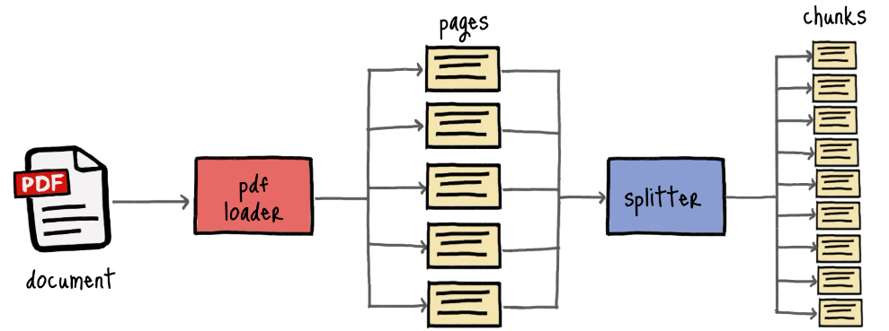
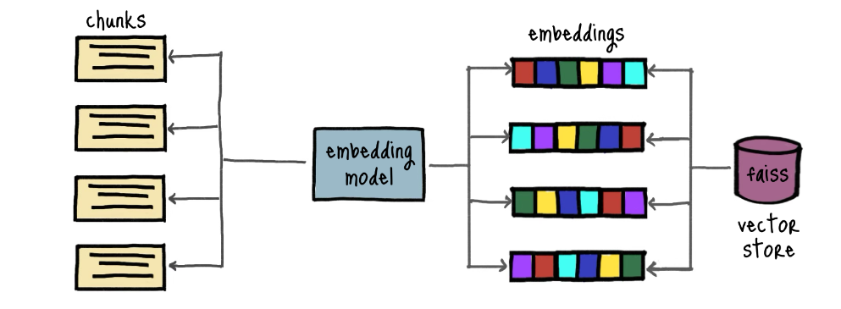
Project: Face Anonymizer Methodology:

Slide 10
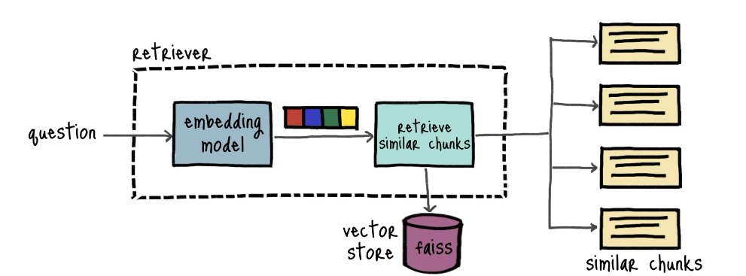
Project: Face Anonymizer Methodology:

Slide 11
Project: Face Anonymizer Methodology:
The project follows a systematic approach for face detection and blurring using Python, OpenCV, and MediaPipe:
PDF Parsing and Text Extraction: The first step involves loading PDF documents using PyPDFLoader. This tool extracts text from PDFs while handling various document structures such as multi-columns, tables, and images. The text is then chunked into manageable sections, ensuring logical flow and coherence for further processing.
Embedding Generation: Once the text is extracted and preprocessed, Ollama embeddings are used to convert the text chunks into vector representations. These embeddings capture the semantic meaning of the text, enabling more precise retrieval of relevant information during query processing.
Vector Store Creation: The generated embeddings are stored in FAISS, a vector database optimized for fast similarity searches. FAISS indexes the embeddings, allowing for efficient search and retrieval of document sections based on user queries. The index is designed to scale with large collections of documents while maintaining low query latency.

Slide 12
Project: Face Anonymizer Methodology:
Query Processing and Retrieval: When a query is received, the system uses embeddings to search for relevant document chunks in the vector store via FAISS, returning the closest matches.
RAG (Retrieval-Augmented Generation) Model: Pass the retrieved chunks to the RAG model, which combines them with a generative model (like GPT) to produce contextually relevant answers.
Response Generation: Generate a clear response grounded in the retrieved content and return it to the user in real time, ensuring relevance and accuracy.
Performance Optimization: Optimize the pipeline to reduce latency through techniques like query batching, parallelization, and caching to maintain responsiveness in real-time applications.

Slide 13
Project: Face Anonymizer Implementation:
The implementation of RAG application using Python and Langchain involves the following steps:
Library Installation: Install necessary libraries such as PyPDFLoader, Ollama, FAISS, and LangChain using Python's package manager. Create a virtual environment to manage dependencies.
PDF Parsing: Use PyPDFLoader to extract text from PDF documents, handling complex layouts and chunking the text into coherent sections for processing.
Embedding Generation: Generate semantic embeddings for the text chunks with Ollama, converting the extracted text into vector representations suitable for retrieval.
Vector Store Creation: Initialize FAISS to create an index for the embeddings, enabling fast similarity searches when processing user queries.

Slide 14
Project: Face Anonymizer Implementation:
Query Processing: Upon receiving a user query, generate its embedding and use FAISS to perform a similarity search, retrieving the most relevant document chunks based on the query.
Answer Generation: Pass the retrieved chunks to a RAG model to generate contextually relevant answers, ensuring responses are grounded in the retrieved content.
Response Delivery: Return the generated answer to the user, maintaining clarity and relevance based on the information extracted from the PDF.
Performance Optimization: Optimize the system for responsiveness by implementing caching and parallel processing to handle multiple queries efficiently.

Slide 15
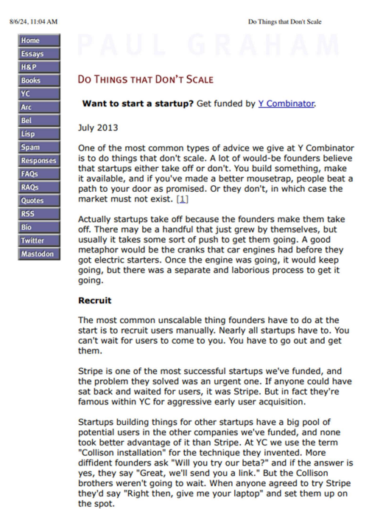
Project: Face Anonymizer Results and Outcome:
(PDF used)

Slide 16
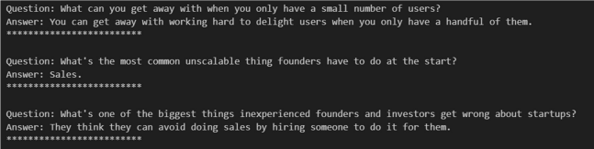
Project: Face Anonymizer Results and Outcome:
Question- Answers

Slide 17
Project: Face Anonymizer Challenges Faced:
Extracting coherent text from PDFs with varied layouts, such as multi-column formats and tables, proved challenging.Lighting and environmental factors affecting detection accuracy.
Generating embeddings that accurately reflect the semantic meaning of diverse document types affected retrieval accuracy.Managing multiple face detections in a single frame.
Maintaining performance during similarity searches in the FAISS vector store became difficult as document volume increased.
User queries often lacked specificity, complicating the retrieval of relevant information.
Ensuring the generative model provided accurate answers while minimizing hallucinations required careful tuning of the RAG model.

Slide 18
Project: Face Anonymizer Skills Gained:
PDF Processing: Gained experience in extracting and managing text from complex PDF structures using PyPDFLoader.Real-time Processing: Proficient in handling and processing live video streams efficiently.
Natural Language Processing: Enhanced understanding of embedding techniques and their application in semantic search with tools like Ollama.
Vector Databases: Developed skills in indexing and performing similarity searches using FAISS, optimizing retrieval processes.
Generative AI: Learned to implement and fine-tune Retrieval-Augmented Generation (RAG) models for generating contextually relevant responses.
System Optimization: Acquired knowledge in optimizing performance for real-time applications through caching, query handling, and parallel processing.

Slide 19
Project: Face Anonymizer CONCLUSION:
In conclusion, the project successfully integrated Retrieval-Augmented Generation (RAG) with advanced document processing techniques to develop a PDF-based question-answering system. By utilizing PyPDFLoader for text extraction and Ollama for embeddings, the system effectively transformed unstructured PDF content into a format suitable for semantic search, ensuring users received accurate and contextually relevant answers.
The implementation of FAISS enabled rapid similarity searches while minimizing hallucination issues typically seen in generative AI models. This project sets the foundation for future enhancements in document management systems, with potential applications across various fields, and highlights opportunities for accommodating diverse document types and improving user interfaces.

Slide 20
Project: Face Anonymizer FUTURE SCOPE:
The RAG Application has several potential improvements:
Support for Additional Document Formats: Expanding the system to handle various formats such as DOCX, HTML, and EPUB, enhancing its versatility in document management.
Improved Natural Language Understanding: Integrating advanced NLP techniques to better handle ambiguous queries and improve the accuracy of retrieved information.
Real-Time Collaboration Features: Developing functionalities that allow multiple users to interact with the system simultaneously, facilitating collaborative document analysis and query handling.
Customization and Adaptability: Implementing options for users to customize the embedding models and retrieval parameters, tailoring the system to specific industries or user needs.
Integration with Other AI Tools: Exploring the integration of additional AI technologies, such as summarization, sentiment analysis, or topic modeling, to provide enriched user insights and analytics from the document data.

Slide 21
REFERENCES:
1. Ng, A. (2021). Machine Learning [Online Course]. Coursera. Available:
Coursera Andrew Ng Machine Learning Specialization
2. Ng, A. (2021). Deep Learning Specialization [Online Course]. Coursera.
Available: Coursera Deep Learning Specialization
3. Goodfellow, I., Bengio, Y., & Courville, A. (2016). Deep Learning. MIT
Press. Available: Deep Learning Book
4. Géron, A. (2019). Hands-On Machine Learning with Scikit-Learn, Keras,
and TensorFlow. O'Reilly Media. ISBN: 978-1492032649.
5. Raschka, S., & Mirjalili, V. (2019). Python Machine Learning. Packt
Publishing. ISBN: 978-1789615857.
6. Scikit-learn Documentation. (n.d.). Scikit-learn: Machine Learning in
Python. Available: Scikit-learn Documentation
7. OpenCV Documentation. (n.d.). OpenCV: Open Source Computer Vision
Library. Available: OpenCV Documentation

Slide 22
REFERENCES:
8. Bishop, C. M. (2006). Pattern Recognition and Machine Learning. Springer. ISBN: 978-0387310732.
9. Murphy, K. P. (2012). Machine Learning: A Probabilistic Perspective. MIT Press. ISBN: 978-0262033189.
10. Hastie, T., Tibshirani, R., & Friedman, J. (2009). The Elements of Statistical Learning: Data Mining, Inference, and Prediction. Springer. Available: ESL Book 11. Zhang, Y., & Yang, Q. (2015). "A Survey on Multi-Task Learning." IEEE Transactions on Knowledge and Data Engineering, 28(10), 2461-2476. DOI: 10.1109/TKDE.2015.2432464
12. LeCun, Y., Bengio, Y., & Haffner, P. (1998). "Gradient-Based Learning Applied to Document Recognition." Proceedings of the IEEE, 86(11), 2278- 2324. DOI: 10.1109/5.726791

